Slide 1
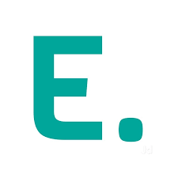
Edgistify.
Innovation
Challenge
2025
Team Cubit
Optimizing supply chain

Slide 2
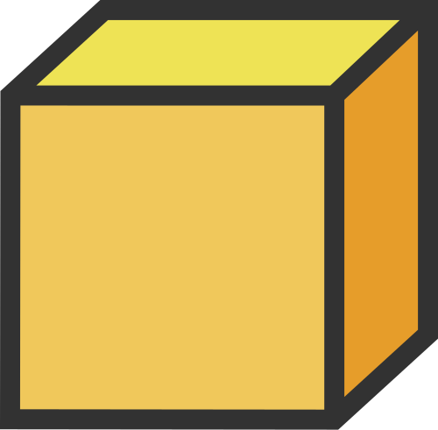
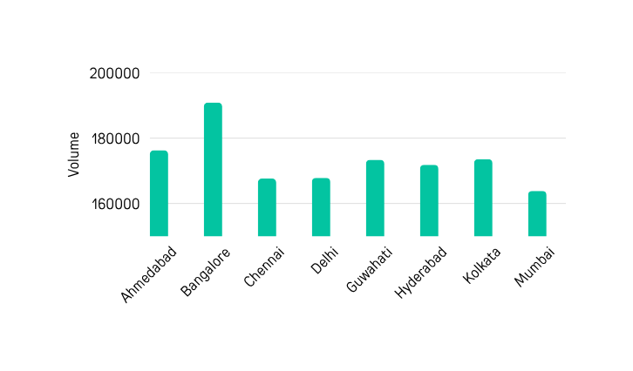
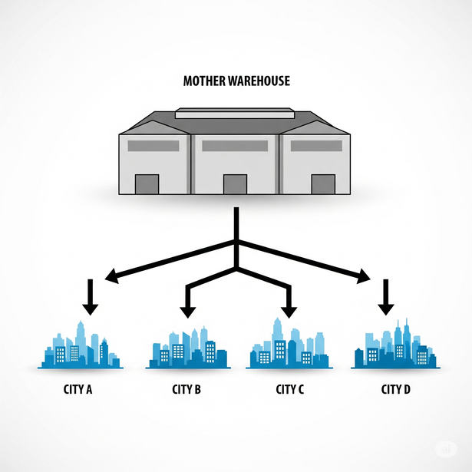
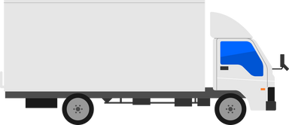
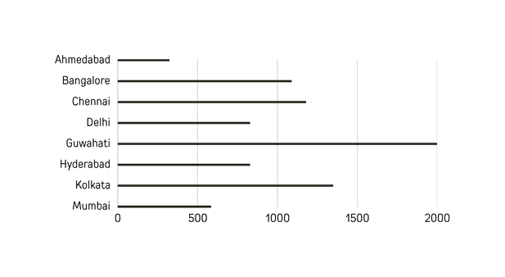
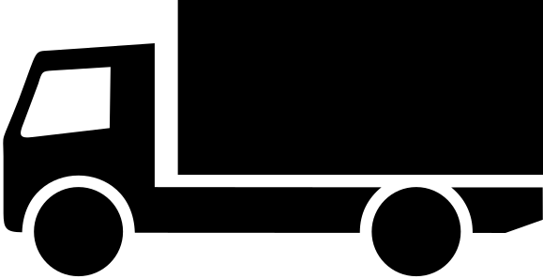
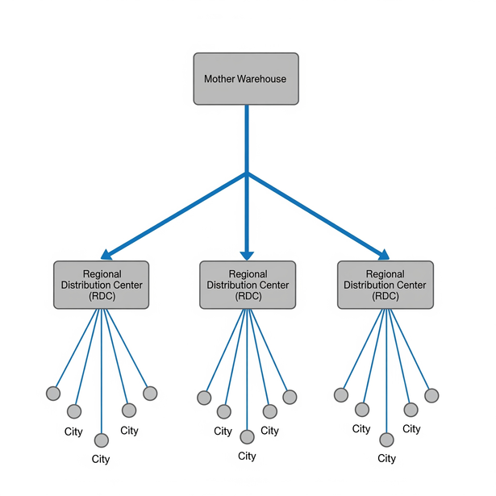
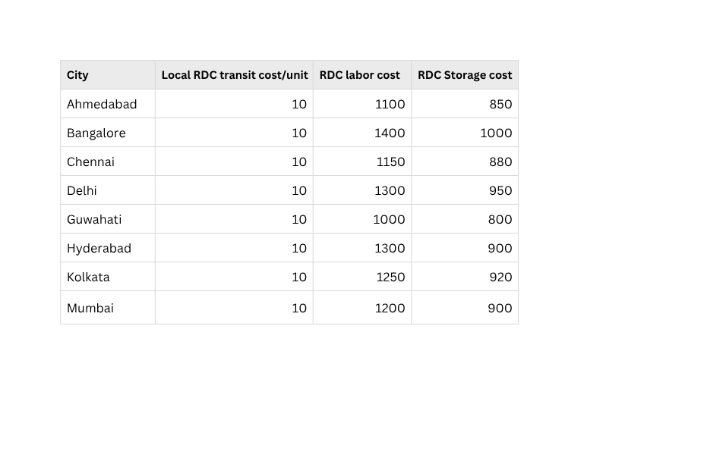
Edgistify.
EIC 2025
Research & insights
Solution & Approach
B2B & B2C Analysis
Layout & Man-Model
Infrastructure Blueprint
Problem statement
Key Statistics
The RDC Shift
A mid-sized Indian brand currently fulfills all B2B and D2C orders from a centralized Mother Warehouse (MW) located in Indore (assumed).
MONTHLY DEMAND PER CITY:
We propose a shift from the current One-to-Many centralized model to a Hub-and-Spoke fulfillment network — selectively deploying Regional Distribution Centers (RDCs) in cities that meet our volume-based break-even criteria.
The company seeks to explore regional fulfillment using RDCs (Regional Distribution Centers) to optimize cost and service.
13.8%
Assumptions
ONE TO MANY MODEL:
Mother Warehouse (MW) Location: it is assumed to be located in Indore, based on guidance received from the Edgistify organizing team regarding synthetic data usage.
Distance b/w cities : Distances between MW and delivery cities are considered as-the-crow-flies road distances
Data ; All demand data is assumed to represent monthly order quantities per city (B2C + B2B combined).
Overhead Price : MW overhead is modeled as a variable cost per unit (₹1–₹2/unit), while RDCs have fixed monthly labor + storage costs.
12.7%
12.5%
12.4%
12.5%
12.1%
12.1%
11.8%
DISTANCE AND TRANSIT COST:
Distance of Cities from MW
325 Km
1090 Km
HUB AND SPOKE MODEL:
RDC Cost
1180 Km
830 Km
2000 Km
830 Km
1350 Km
585 Km
*Note: we have assumed the mother warehouse to be in indore

Slide 3
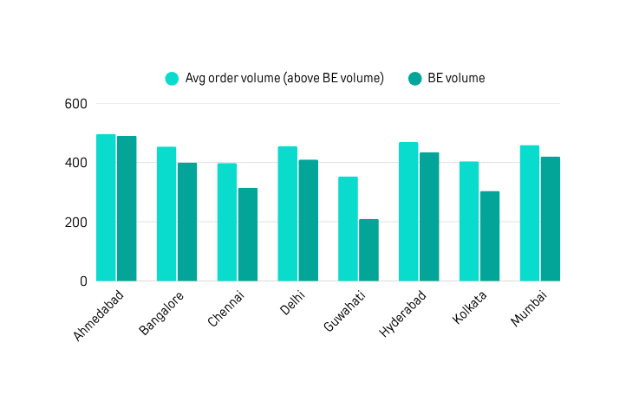
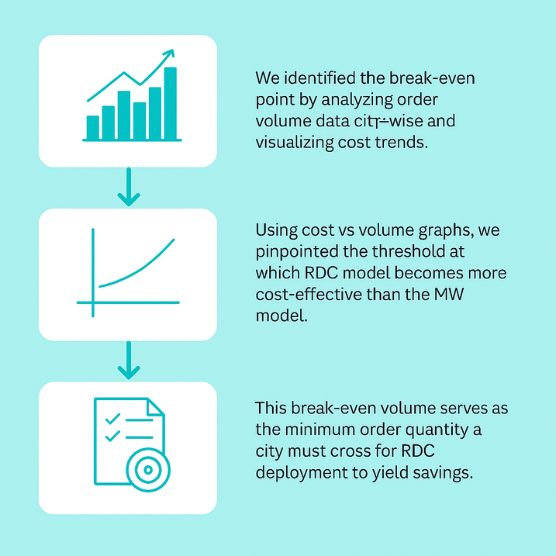
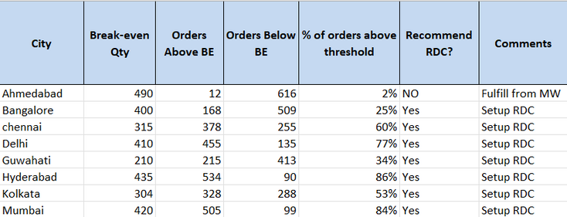
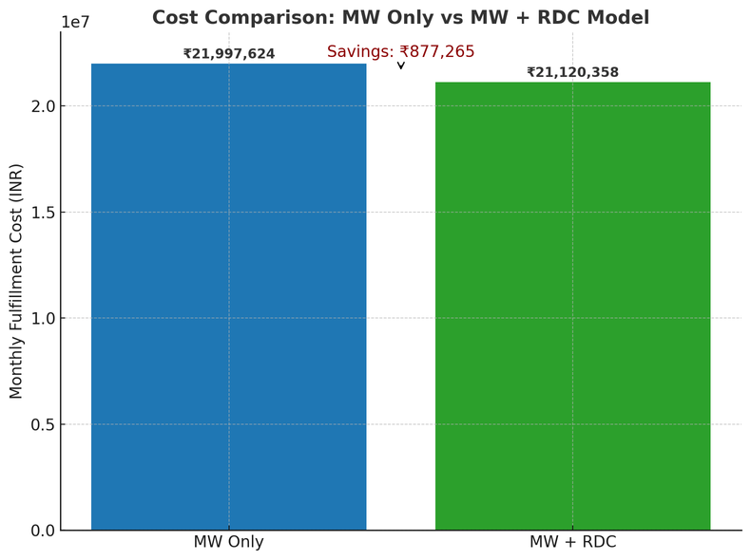

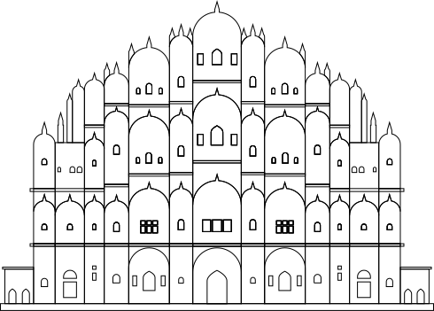

Edgistify.
EIC 2025
Research & insights
Solution & Approach
B2B & B2C Analysis
Layout & Man-Model
Infrastructure Blueprint
OUR SOLUTION
Average Volume(Above BE) V/S BE
Approach: Finding the Break-even Point
The RDC Shift
We propose a hybrid model where only orders above the break-even volume are fulfilled via Regional Distribution Centers (RDCs)
orders below the break -even point continue to be fulfilled from the Mother Warehouse (Indore) to avoid unnecessary RDC costs.
This approach ensures RDCs are utilized only where they yield cost efficiency.
We identified the break-even point by analyzing order volume data city-wise and visualizing cost trends.
Using cost vs volume graphs, we pinpointed the threshold at which the RDC model becomes more cost-effective than the MW model.
This break-even volume serves as the minimum order quantity a city must cross for RDC deployment to yield savings.
Cost-Saving Overview
*Break-even volume shows the point where fulfilling from RDCs becomes more cost-effective than the Mother Warehouse
*Detailed break-even graph available in Appendix Slide X*
Strategic RDCs Locations
🧭 Final Fulfillment Strategy
Deploy RDCs in 6 cities exceeding break-even volume
Retain MW fulfillment in low-volume zones
Target monthly savings of ₹8.77L (↓ 4%)
Enable scalable, regionally optimized network
Bangalore
Chennai
Delhi
Kolkata
Guwahati
Hyderabad
Chennai
Fulfilling orders via RDCs in cities where volume exceeds the break-even point results in monthly savings of ₹8.77 lakh

Slide 4
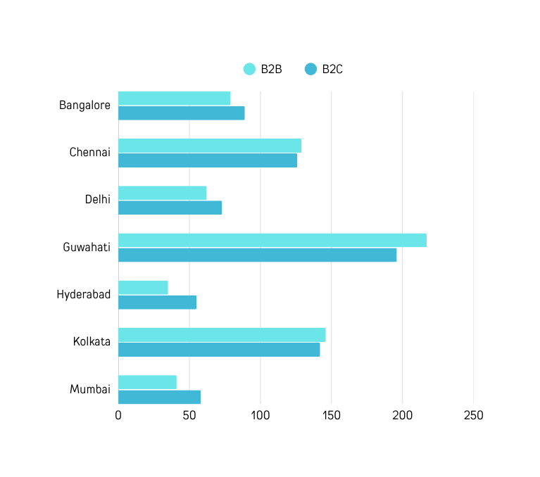
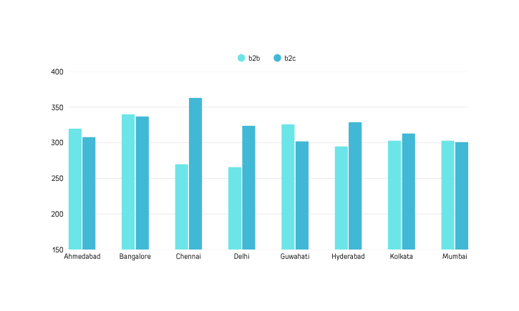

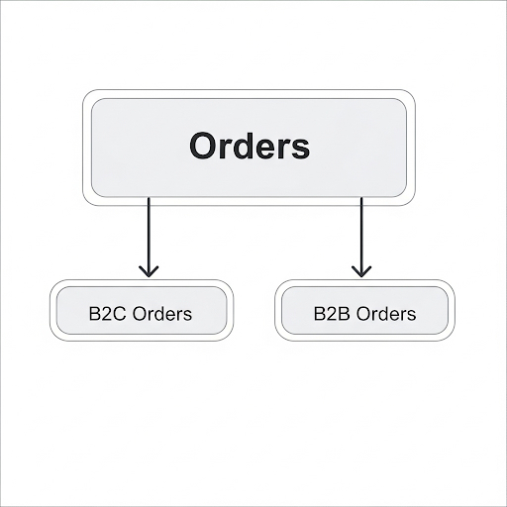
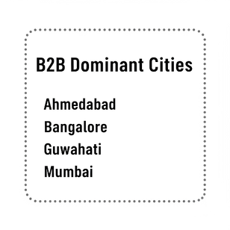
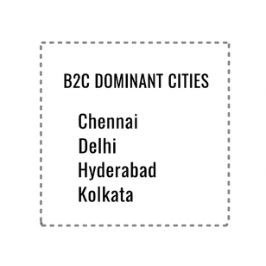
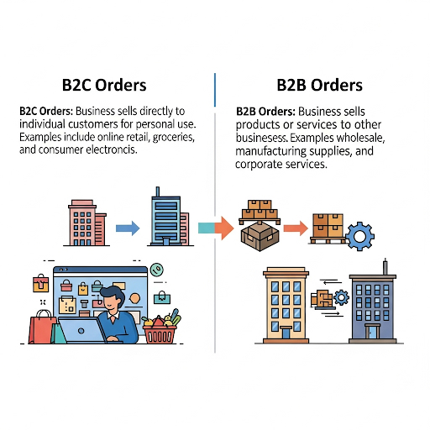
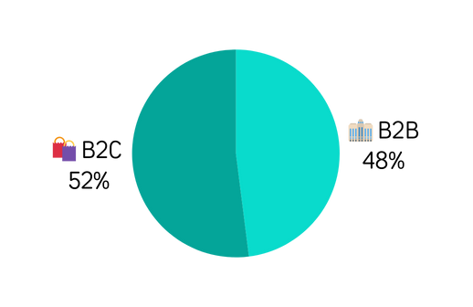
Edgistify.
EIC 2025
Research & insights
Solution & Approach
B2B & B2C Analysis
Layout & Man-Model
Infrastructure Blueprint
Understanding Demand Type
Order Type Segmentation: B2B vs B2C
B2B vs B2C Orders in Proposed RDC Cities
While our RDC rollout was primarily volume-driven, analyzing B2B and B2C order distribution helped us understand demand behavior across cities.
Distribution of Total Orders by Type
Guwahati, Chennai, and Kolkata show strong B2B volumes — these cities are ideal for RDC routing of bulk, high-volume orders.
Bangalore and Delhi have a more balanced B2B:B2C split, allowing for a hybrid fulfillment approach.
Understanding order types (B2B/B2C) didn’t influence current rollout decisions but strengthens our long-term strategic lens.

Slide 5












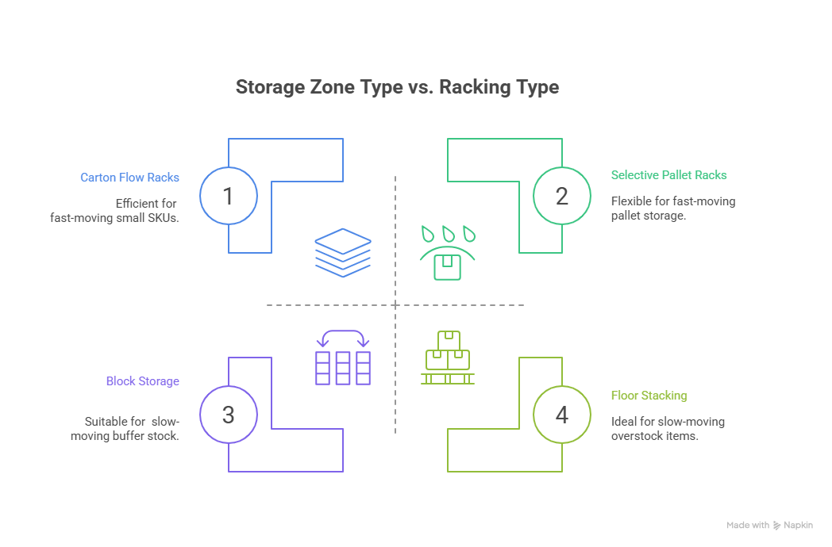


Edgistify.
EIC 2025
Research & insights
Solution & Approach
B2B & B2C Analysis
Layout & Man-Model
Infrastructure Blueprint
Mother Warehouse Layout
Mother Warehouse Features
Man Model ( avg v/s peak)
We modelled peak manpower based on the expected 3× future throughput
TRUCK BAY 1
(INBOUND)
RECEIVING & QC ZONE
STORAGE 1
(FAST-MOVING)
ROLE | AVERAGE (CURENT) | PEAK x3 (FUTURE)
no. of picker | 93 | 279
no. of packer | 154 | 462
no. of unloader | 46 | 138
total labour | 293 | 879
no of supervisor | 12 | 36
STORAGE 2
(MEDIUM-MOVING)
STORAGE 3
(SLOW-MOVING)
STORAGE 4
(OVERSTOCK)
TRUCK BAY 2
(OUTBOUND)
LOADING & DISPATCH
VAS + PICKING & PACKING
Admin Block | Office | IT/WMS Room | Battery Charging Zone | Break Room
ASSUMPTIONS IN MAN MODEL
Average Order : 46,178 units/day
1 picker can handle 500 orders/shift
1 Packer can handle 300 orders/shift
1 Unloader: can handle 1,000 orders/shift
Supervisor Ratio : 1 per 25–30 workers
Shift Planning:
- Avg: 1 shift/day
- Peak: 2–3 shifts for full load handling
Scaling: Linear scaling assumed
Why this layout supports 3× scale:
Modular zone-based design allows lateral expansion
Vertical racking enables higher SKU density
Buffer space reserved for overflow & automation
Process flow prevents congestion under high load

Slide 6
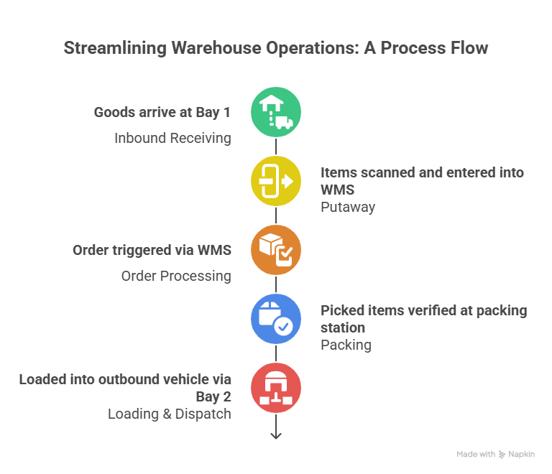
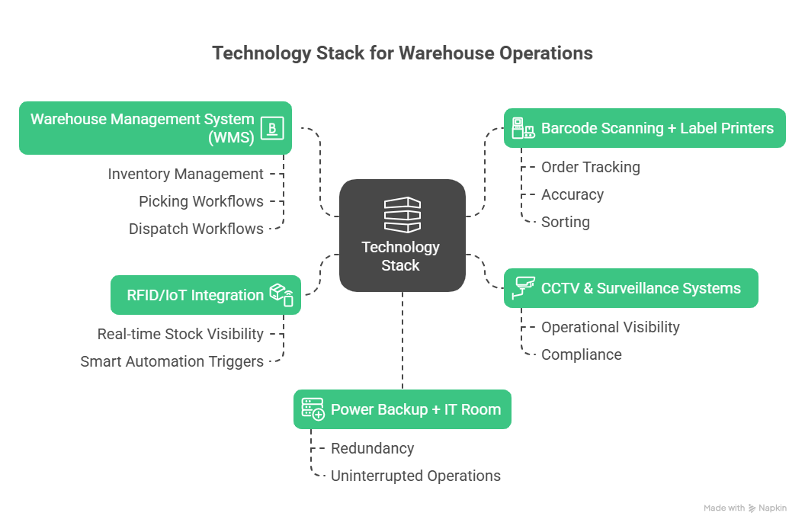
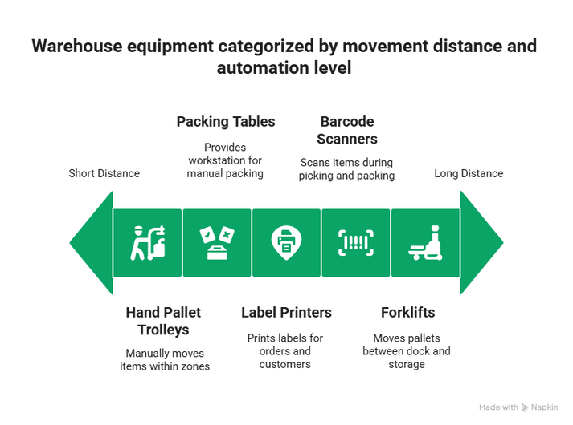
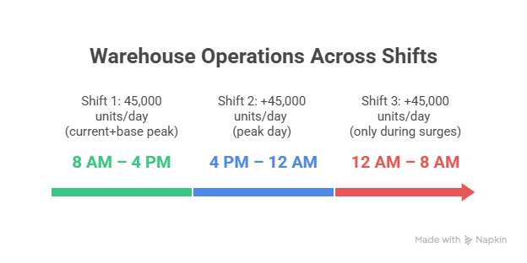
Edgistify.
EIC 2025
Research & insights
Solution & Approach
B2B & B2C Analysis
Layout & Man-Model
Infrastructure Blueprint
Process Flow & Shift Capacity
Infrastructure Blueprint: Tech & Equipment
*A Warehouse Management System (WMS) is a software platform used to manage and optimize day-to-day warehouse operation
Warehouse equipment categorized by movement distance and automation level

Slide 7
THANK YOU

